Slide 1

Notes:
Graduate student working on a collaborative project in Computer Vision at Harvard and MIT.
In the interest of the fact that you all have had a long day, this talk is going to be less about giving you answers, and more about asking you intriguing questions to motivate you and go read up interesting stuff. So be prepared for interesting questions about artificial intelligence, some really cool demos, and some awesome optical illusions!
I’d like to begin with a short clip.
Now that we have seen the importance of vision, How do we give Wall the power of sight? What are the challenges we can face, and how do we address them?

Slide 2
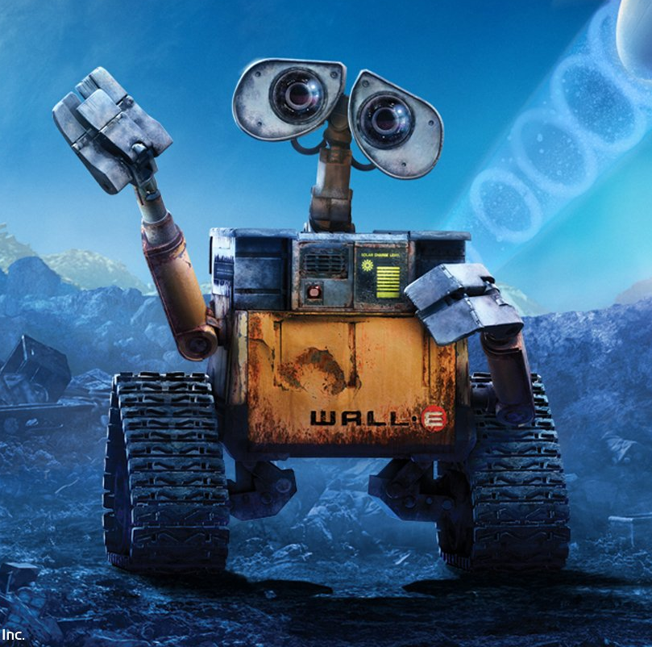
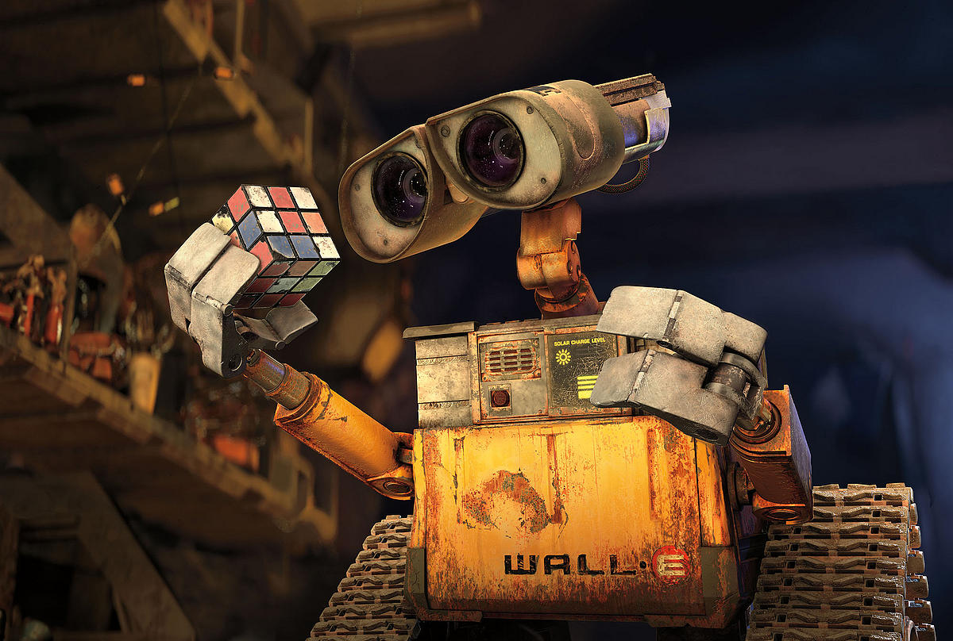


How do we make Wall-E capable of seeing the world around him?
- SPANDAN MADAN
Notes:
Just looking at these pictures what are the capabilities wall-e must have – 1) He needs to know that he’s looking at a person, as he’s saying Hi. 2) He needs to know he’s holding a rubik’s cube. And at that, an unsolved one. So we can see, that the capability of vision can be divided into a number of interesting questions – Identifying objects, identifying people (as facebook does when it lets you tag your friends).
This brings us to our next problem - What are some important components of computer vision? And why is it so challenging to make these components

Slide 3
Some important components of Vision
Detecting Objects – Like finding a chair?
Identifying people?
Understanding what’s happening in a scene?
Understanding Color?
…. And Many More

Slide 4
So what makes these SO hard?
Notes:
In order to best appreciate the toughness of the problem, let’s have you try and perform these tasks. After all, you have a better visual system in your eyes than any computer in the world!

Slide 5


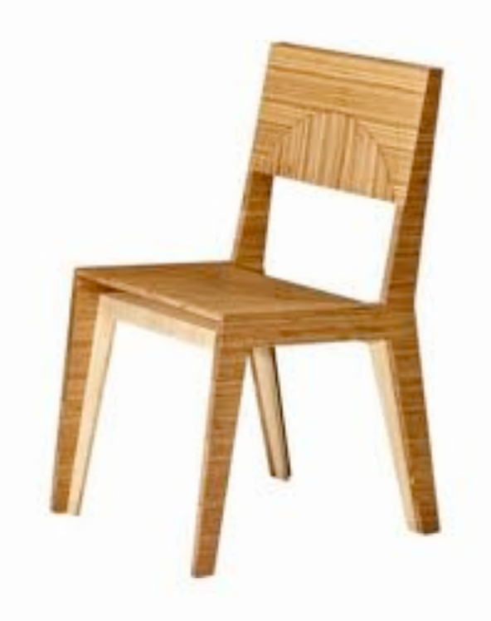
Challenge 1: help a robot recognize a chair
Notes:
If you want to teach a robot how to recognize a chair. How would you teach it what a chair is. Any ideas?

Slide 6

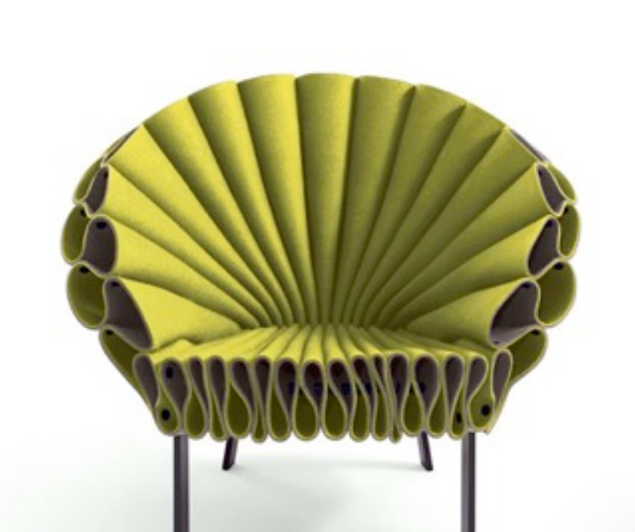

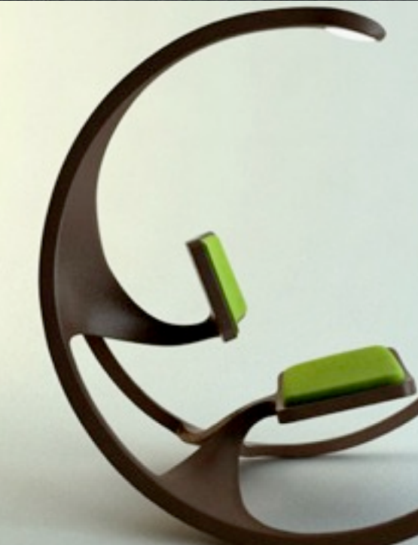
But… aren’t these also chairs? :/
Shape definitely doesn’t seem to work
Maybe, it’s a surface on the ground that we sit on?
Zoya Byllinskii’s slides
Notes:
But then, how do we account for these cases?
So, do we redefine to make it more general?

Slide 7
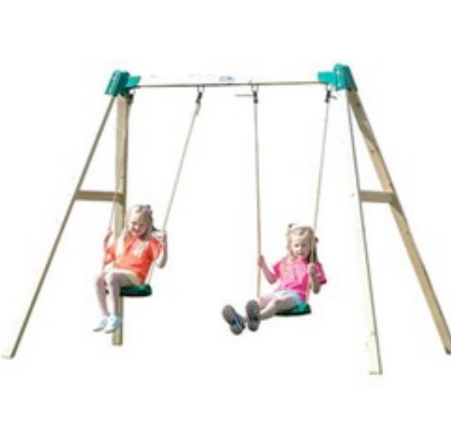


Naah, this does doesn’t work either – None of these are chairs!
Surface on the ground used to sit?
Zoya Byllinskii’s slides
Notes:
This brings us to the question, how do we really go about solving it?
In order to know why we can can see and interpret so effortlessly, and a computer can’t let’s try and understand the difference in our perceptions. What do we see, and what does the computer see?

Slide 8
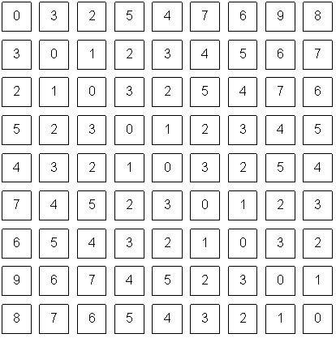

What we see v/s What Wall-E sees Making sense of Pixel Values
V/S
Jinxiang Chai
Notes:
The power of creating artificial vision, is called as computer vision. And the field began right here, at MIT. If you join MIT,
Well it starts from right here, at MIT.
And if you join MIT and take the class on AI or vision, you’ll get to know the whole story in detail ☺ But,

Slide 9
A bit of Magic or A whole lot of Math?
Notes:
This brings us over to machine learning!

Slide 10
What is the machine learning in Machine learning?
y = f(x)
When f is known – Problem solved! Ex – Effect of force on acceleration, f is known!
When f is not known, say your movie preference = f(age, parent’s occupations, your preference in music). – LEARN IT!
This process of approximating f, by another function g is called Machine Learning!
Notes:
Let

Slide 11
How do we learn g?
Intelligently trying lots of options!
Using complex combinations of simple functions – Neural Networks. Basically learns how to fit the equation “y=mx+b” millions of times!
“The Right Representation” – The holy grail of Machine learning!
Notes:
So what is representaiton?

Slide 12
Representation – knowing which inputs to use in Machine Learning
Me – A graduate student working at MIT, who likes statistics and loves to spend time trying to solve problems in computer vision.
V/S
Me – An international student who loves music, and is waiting eagerly for Roger Water’s concert later this year.
What describes me best – Depends upon the question you’re asking about me!
Notes:
If you want to know my music preferences, the latter is the better. To know my research interests, the former. So, depending upon how

Slide 13
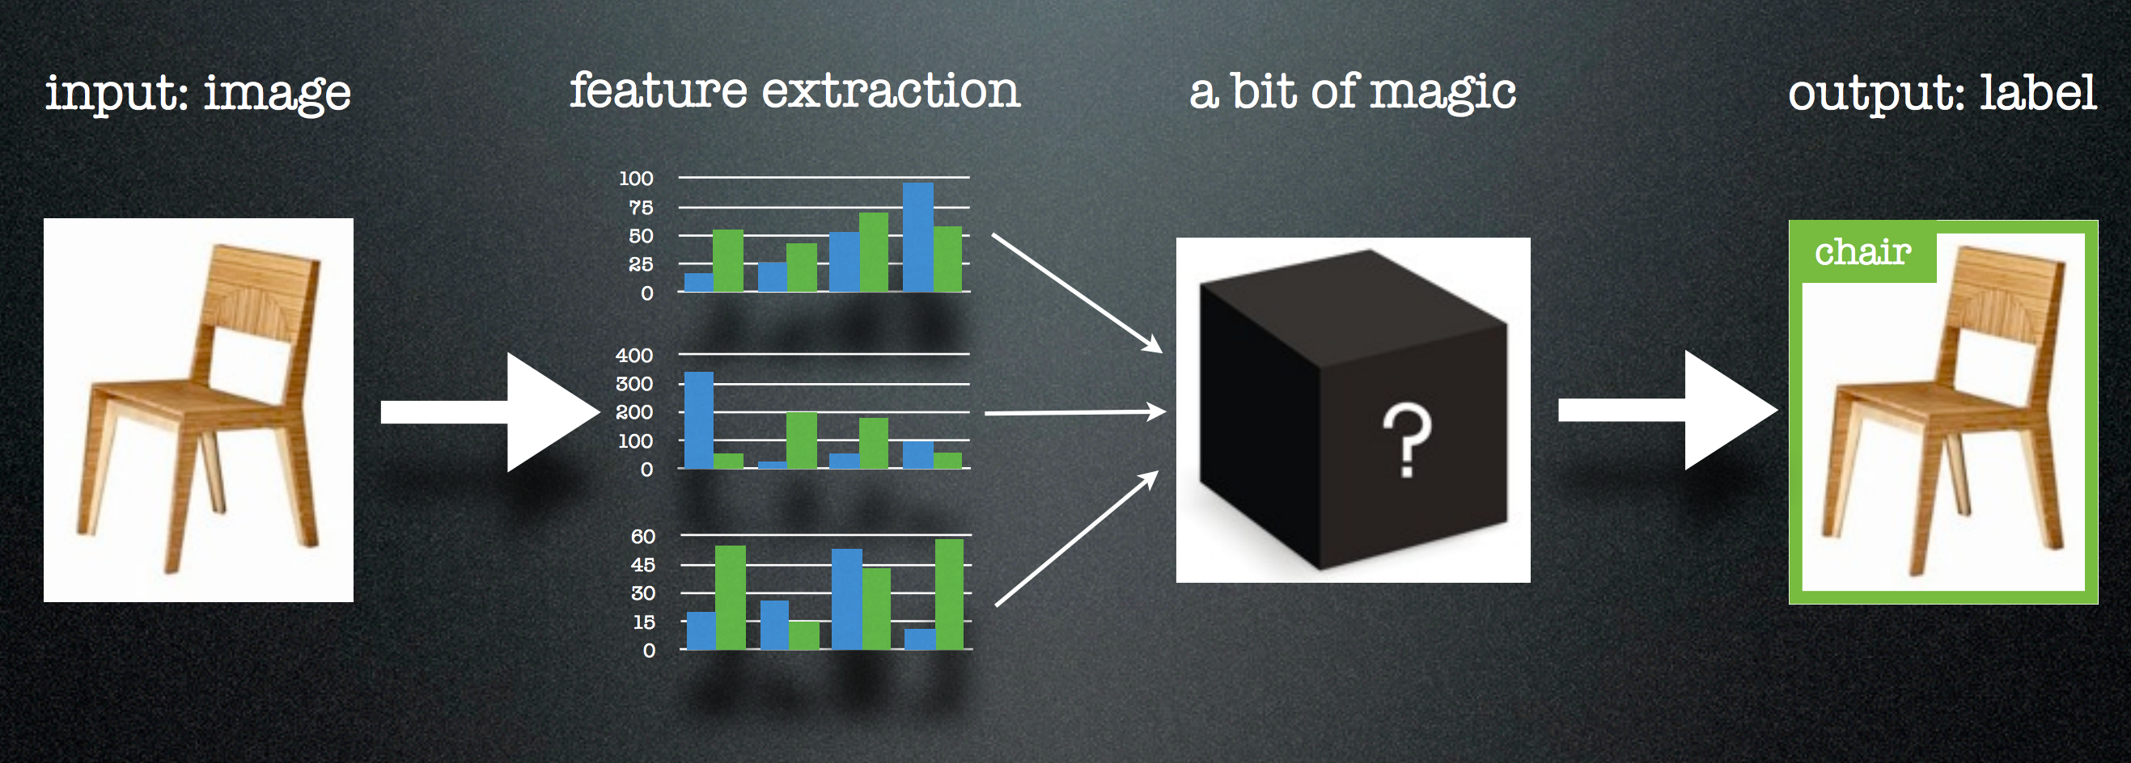
How is the chair problem solved?
Zoya Byllinskii’s slides

Slide 14
Neural Networks : intuition
Combine finding ideal representation and using it to learn ”g” in a single pipeline.
Linear Combination of lots of Non-Linear functions = can approximate very complex functions!
Tries assigning different levels of importance to different aspects of data till it finds a combination that works.

Slide 15
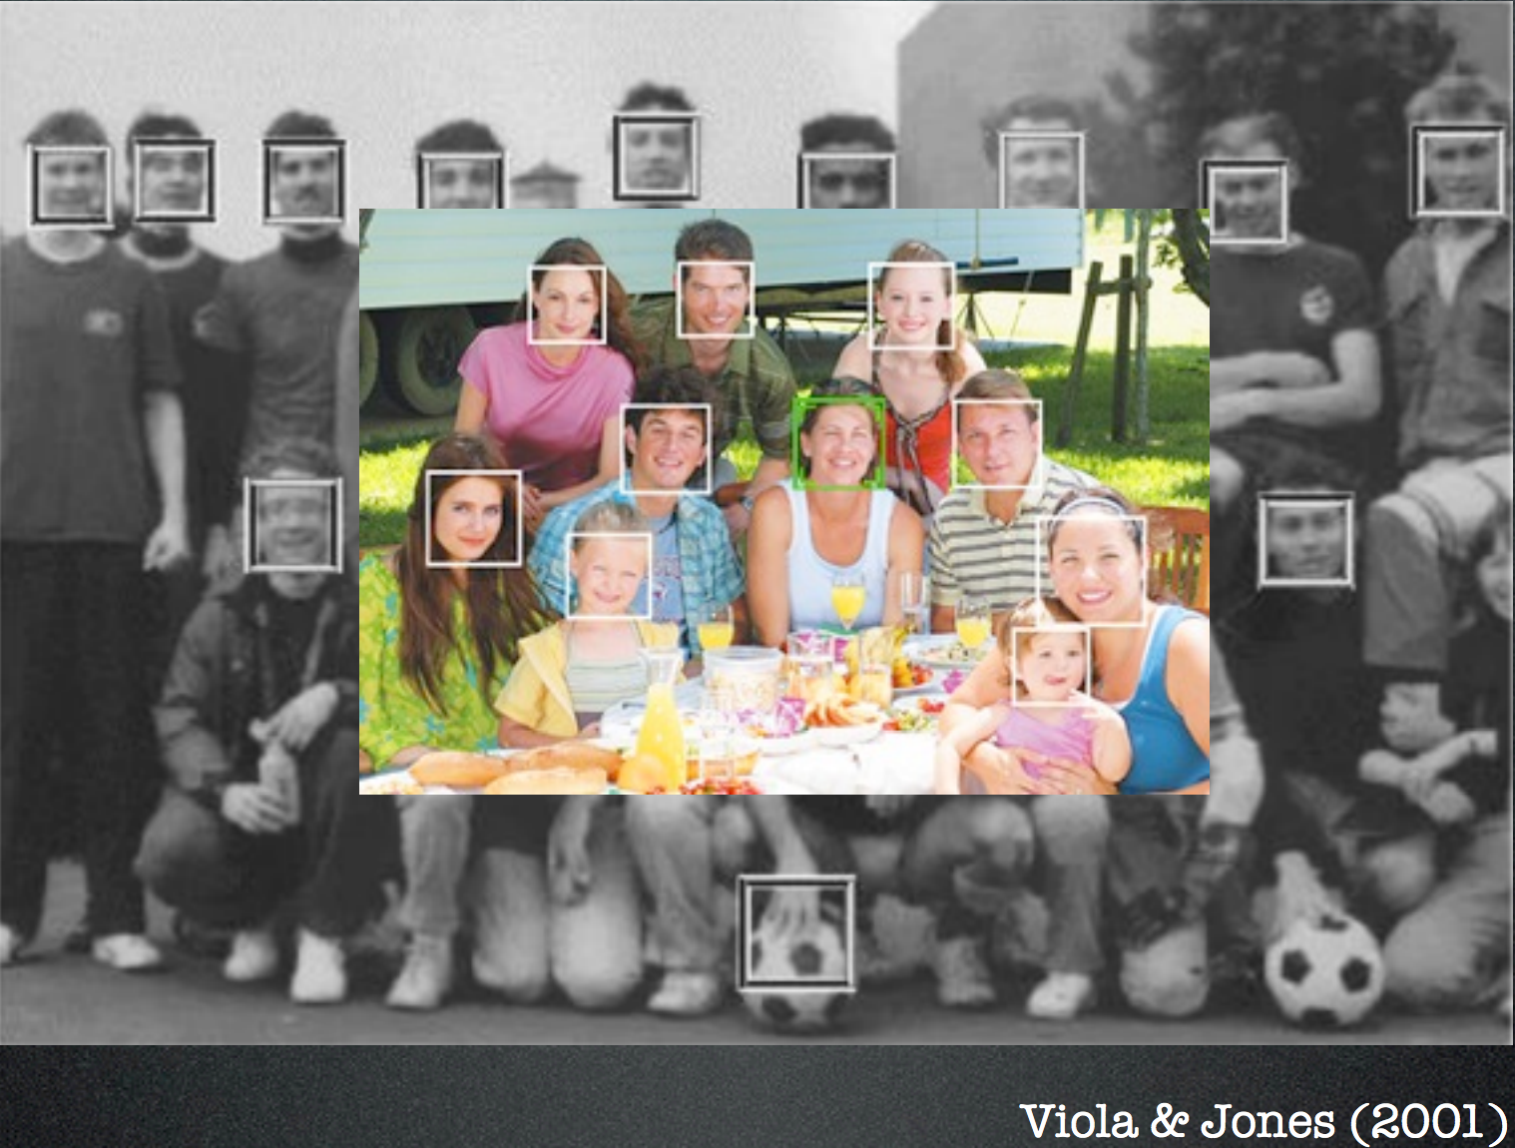
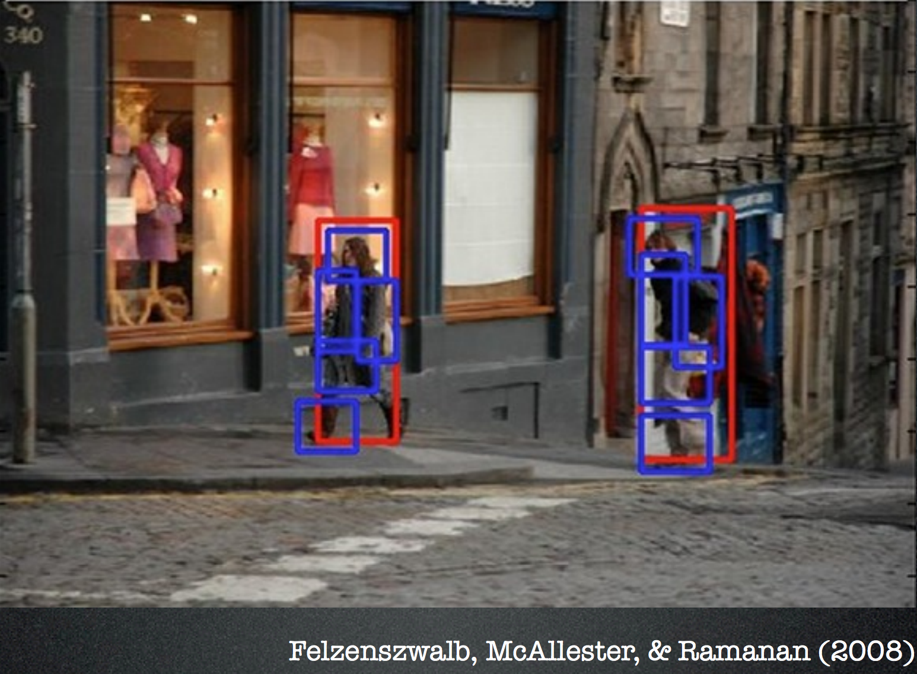
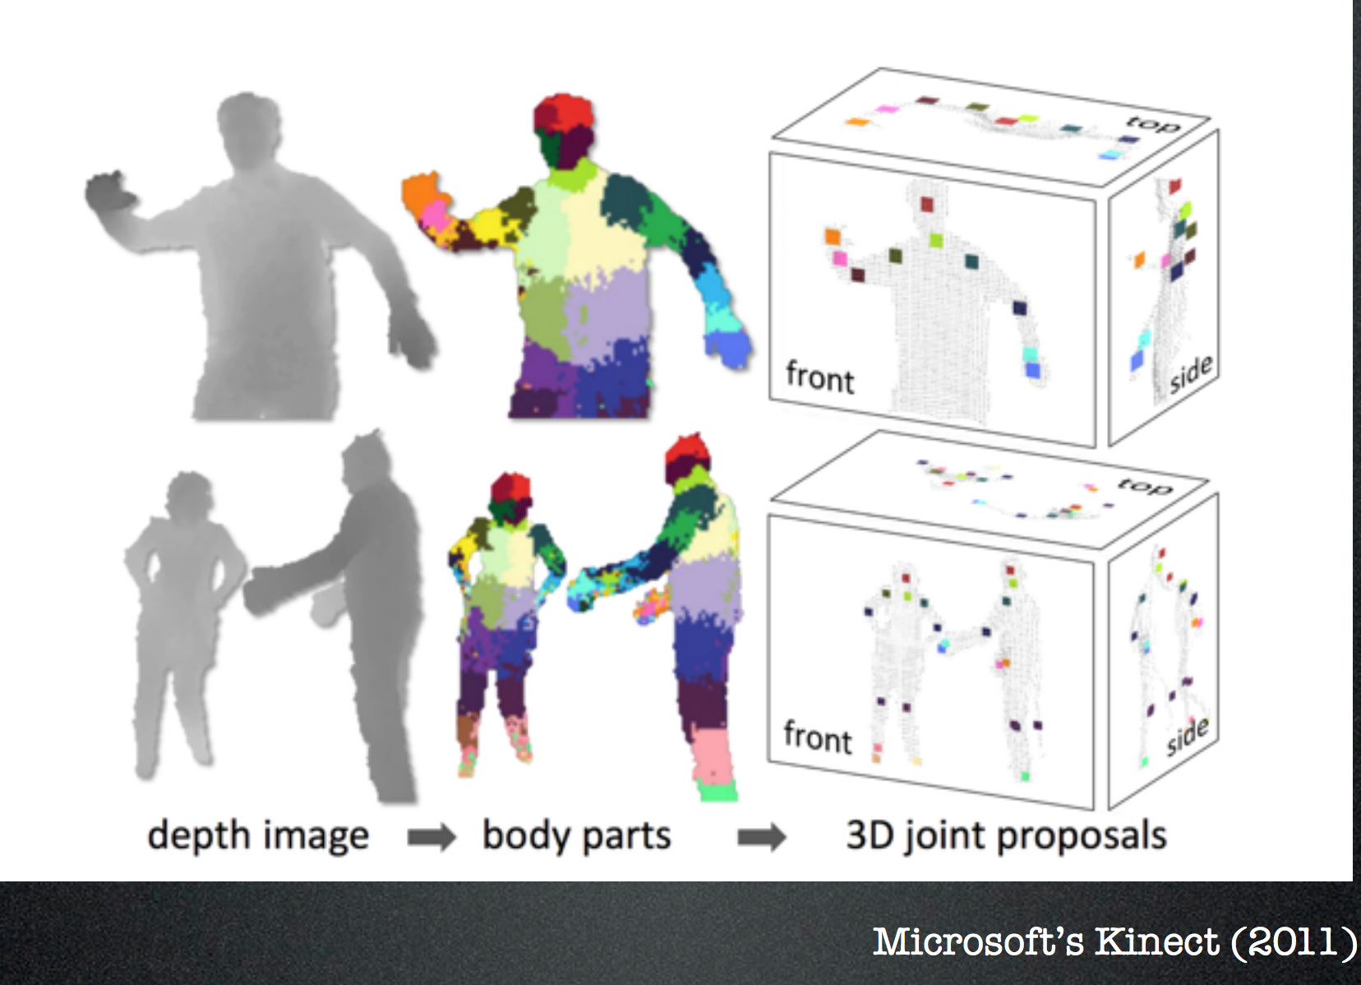

Let’s see some of the big successes in the field?

Slide 16
Let’s see a Demo?
Can I get this code?

Slide 17
Summary
Computer Vision is cool!
…… and super hard
But, we have mathematics to fall back on!
Machine learning tries to “learn” a function g, which can approximate an unknown function f.
It’s all in the Representation – input to your machine learning function!

